Slide 1
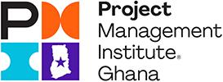
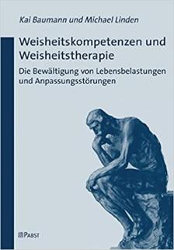
Wisdom:
how to solve problems and to cure VUCA
Thomas Walenta
November 2021
based on: medical research published in Berlin, Charite hospital
Kai Baumann, Michael Linden: Weisheitskompetenzen & Weisheitstherapie, Pabst Science Publishers 2008

Slide 2
Why this topic
Who am I?
1st project 1974, 1st PMO 1995, 1st program 2001, 31 years @ IBM, PMI Fellow, PMP, PgMP
What will you learn?
what is wisdom, how to build it, where do you stand Wisdom cures VUCA
Why should you learn it?
improve your capability to handle life and projects

Slide 3
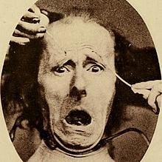
Do you remember FUD?
Fear, Uncertainty, Doubt
Term coined by Gene Amdahl after leaving IBM 50 years ago
marketing strategy to instill FUD about a competitor
also used in politics
emotions are bad advisors!

Slide 4
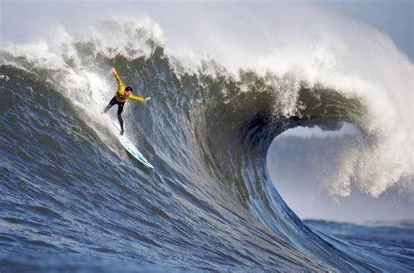
thrill
choices
curious
exploring
Is VUCA the new FUD?
volatility
uncertainty
complexity
ambiguity
The VUCA world
Is VUCA real?

Slide 5
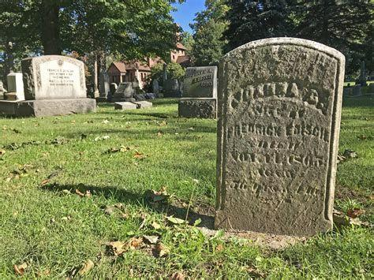
Opposite of the VUCA perception
stability
certainty
simplicity
clarity
SC² vs VUCA
Is this better? Do we need both views?

Slide 6
Positive feelings facing VUCA:
volatility
uncertainty
complexity
ambiguity
thrill
choices
curious
The VUCA world
exploring
Who tells you VUCA is bad? Why? FUD?

Slide 7
Find the balance
VUCA
- day
- antifragile
- strive
Balance
Our own choice
WISDOM
SC²
- night
- resilient
- survive
Volatility
Stability
Uncertainty
Certainty
Complexity
Simplicity
Ambiguity
Clarity
It’s your conscious choice

Slide 8
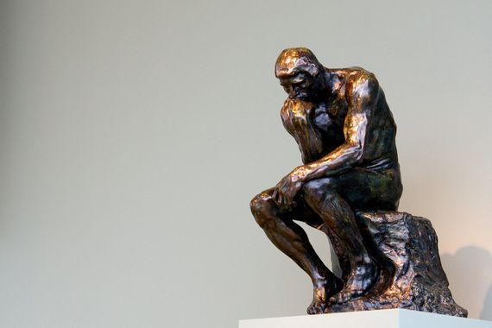
10 Competencies from medical research
1. changing perspectives
2. empathy
3. awareness & acceptance of own emotions
4. emotional balance, serenity
5. knowledge about facts & problem solving
6. contextualism
7. relativism for values
8. oriented towards sustainability
9. uncertainty tolerance
10. self distance
Wisdom: 10 competencies
to build & maintain
How to improve?

Slide 9
Wisdom roots deep.
Wisdom defined: Wikipedia: .. ability to contemplate and act using knowledge, experience, understanding, common sense and insight.
Baltes: .. Expert Knowledge concerning the fundamental pragmatics of life. (make sense of life)
It’s the fundamental pragmatics of life.
Notes:
https://youtu.be/SvMiXk2gGSk
https://berlinwisdommodel.weebly.com/baltes-definition-of-wisdom.html

Slide 10
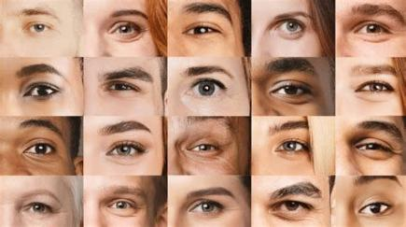
1. Competence to change perspectives
gain experiences that show that other’s views can be a solution to my problems
ability to see a situation from another’s view
examples: Salomonic solutions, Gordic knot, paradox intention, glass is half full, think outside the box
how to improve: change roles (role play, actor), try seven hats (deBono), always look for alternatives, design thinking, walk in the other’s shoes, focus outside ..
https://youtu.be/eukpuF9Nt8k
Notes:
Photo left, text right: reading habit, photos, rather than text, catch eyes first anyway
Principle:
Max 3 points, each has as less as possible key words.

Slide 11
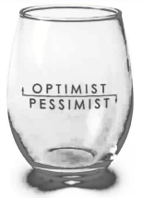
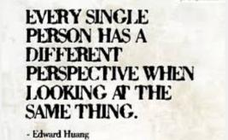
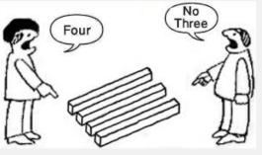
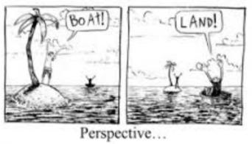
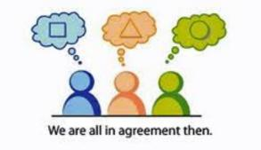
https://www.youtube.com/watch?v=QGhEjC-5WDE

Slide 12
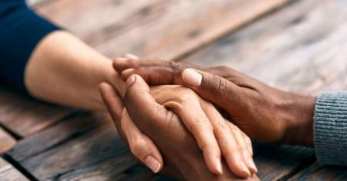
2. Competence empathy
emotional competence to understand the other’s feelings
examples: feel touched, feel (un)fairness or (dis)respect
how to improve: focus from inside to outside, active listening, watching, interacting, networking

Slide 13
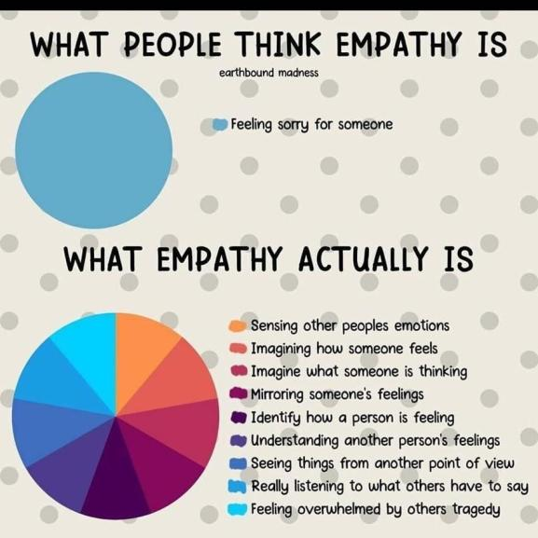

Slide 14
3. Competence to be aware of and accept own emotions
emotional competence to feel and differentiate one’s own emotional states – self awareness
and then being able to accept them (even if they are negative)
leads to confidence and authenticity
examples: grief – joy, crying in a movie, laughing, excitement
how to learn: name your feelings, feel them deeply, identify the triggers, JoHaRi Window

Slide 15
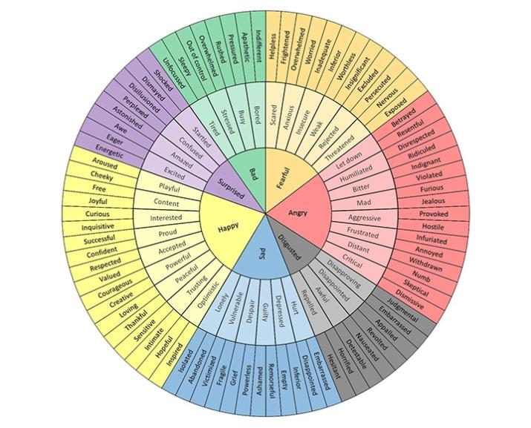
Robert Plutchik, 1980

Slide 16
4. Competence to balance emotions, serenity, self-control
peacefulness, staying quiet, patience, balance
control visibility of own emotions to others
enables distance to triggers and freedom to act
examples: poker face, amplification, masking, humor, self-irony
how to learn: meditation, being centered, mindfulness, know your triggers, get feedback, have a mentor, minimize blind spots

Slide 17
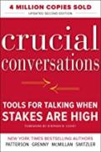
Self-Control: Crucial Conversations (Grenny et al.) Understand (and mitigate) automatic emotional reactions engrained in our brain
diversity
curiosity
habit
culture
experience
learned
beliefs
perception
values
Trigger, see & hear
incomplete
Make sense, tell yourself a story
judgement, feeling
(re-)act
question to triggerer (more data?)
question to
yourself (is this the right story?)

Slide 18
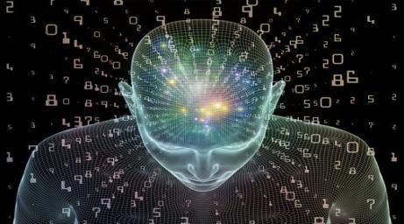
5. Knowledge about facts & problem solving
knowledge to survive and to strive
assimilation: apply known schemes to situations > heuristic intelligence, facts WHAT
accommodation: find unknown schemes > epistemic intelligence, know strategies to solve problems HOW
examples: Delphi Oracle, Mentor, Nestor
how to learn: read, listen, connect, play (experiment) and exercise

Slide 19
6. Contextualism
events and perceptions depend on context
classify events & perceptions based on situation, timeline/history and social relevance
enables to take another perspective
systems thinking
examples: stakeholder analysis, design thinking, networking, exploring
how to learn: practice convex/divergent thinking, de-focus, widen your viewpoint, ask others, get a mentor

Slide 20
7. Relativism for values / tolerance for pluralism (diversity)
accept the value system of others while preserving your own perspective
respect other opinions without seeing them as an attack to our own
in contrast to rigidity and mono-causality
examples: there are many truths (non monism), democracy, integration - not assimilation - of immigrants, learn Ubuntu (I am because you are)
how to learn: delay responses, ask for reasons, travel the world, read about other cultures, be open for strangers, get close to universal human values

Slide 21
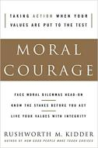
Ethical values describe triggers to our emotions
8 human values found in most human cultures (Rushworth Kidder)
Responsibility, accountability
Respect, mindfulness, tolerance, diversity
PMI Code of Ethics and
Professional Responsibility
Fairness, justice, equitable
Honesty, truth, integrity
Freedom, autonomy
Community, family, relatedness
Compassion, care, love, help
Compassion, Care, Love
Humility, reverence for life
Notes:
The late Rushworth Kidder was a researcher for human values and ethics. He founded the Institute for Global Ethics in 1990.
In quintessence he found most humans in most tribes and cultures to share common human values. We all have negative feelings if one of those values is violated by ourselves or even others. On the opposite, we feel touched and happy if we see the values being upheld.
The first 4 values listed you also find in PMI’s Code of Ethics and Professional Conduct. PMI did not know the research of Rushworth Kidder, but the volunteers concentrating on them when they formulated the Code seemed to have a good understanding about their own feelings.
The last 4 values, freedom, relatedness, care and humility can be observed during crisis’ like Corona.

Slide 22
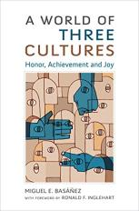
Global cultural system – a model to understand others
(based on A World of Three Cultures: Honor, Achievement and Joy by Miguel E. Basáñez)
3 hyper cultures |  | Achievement | Joy | Honor
Legal system, historic context |  | Roman law, industrial | Common/case law, post-WWII | Islamic law, pre-industrial
Typical behaviors |  | Punctuality / efficiency, rationality, job > family | Family / friendship, learning, sense of agency | Respect for tradition / authority, patriarchy, family > job
Key dominant values |  | Hard work reward / punishment (economic – harmony vs mastery) | Trust / family (social – autonomy vs embeddedness) | Autonomy vs obedience (political – hierarchy vs egalitarism)
8 macro cultures | Main religions | Protestantism, Judaism, Confucianism | Catholicism, Buddhism | Islam, Christian orthodoxy, Hinduism
200 mezzo cultures | Nationality | Western Europe, US, China, Japan, Sweden, Norway | Latin America, European Catholics, Italy, Spain | Islamic countries, India, Zimbabwe, Pakistan
800 micro cultures | Language | Ghana 97/101 Germany 9/101 | Ghana 86/100 Germany 35/100 | Ghana 5/101 Germany 93/101

Slide 23
8. Oriented towards sustainability (will power)
ability to delay gratification
pursue and reflect long-term goals
understand different consequences of decisions
examples: marsh-mellow test, Hofstede’s long-term-orientation in cultures
how to learn: look at positive/negative and short/long term consequences of any decision, be patient, set mid/long term goals, self-control
https://youtu.be/Yo4WF3cSd9Q

Slide 24
9. Uncertainty Tolerance
Life comes with (is) uncertainty
accept that no result is 100% predictable or controllable
Panta Rhei (everything is in flow, Heraklit)
example: swim in river, bungee jumping, start a project
how to learn: prepare for multiple outcomes (strategize), recognize positive surprises, ask ‘what if..’ questions

Slide 25
10. Self distance, humility
Accept there are higher goals than your own well-being
Accept that you are not the center of the universe
opposites: narcissism, envy, bragging, pride, greed
be a giver, not a taker (see Adam Grant)
examples: ‘I know that I know nothing’ (Socrates)
how to learn: focus on others, be self-aware

Slide 26
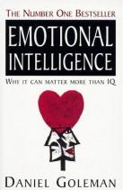
Emotional Intelligence – a base for wisdom and leadership
3. Competence to be aware of and accept own emotions
4. Competence to balance emotions, serenity, self-control
me
compassion: self-motivation, flow
self awareness: confidence, authenticity
self control: mindfulness, resilience
empathy: learning, understanding, listen organizational awareness
influence: leadership, impact, conflict handling, negotiations
observe
act
Stakeholder Management
2. Competence empathy
you

Slide 27
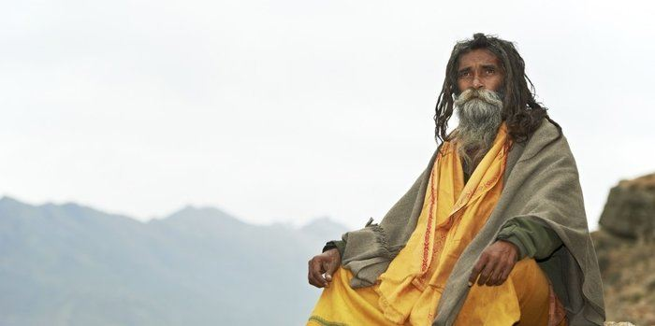
Improve competencies to increase your Wisdom level.
1. changing perspectives
2. empathy
3. awareness & acceptance of own emotions
4. emotional balance, serenity
5. knowledge about facts & problem solving
6. contextualism
7. relativism for values
8. oriented towards sustainability
9. uncertainty tolerance
10. self distance
Wisdom: know how to live

Slide 28
Know yourself better.
 |  | Competence level
 | Competency | beginner | some | balanced | much | expert
1 | changing perspectives
2 | empathy
3 | self-awareness
4 | serenity, balance
5 | knowledge: facts & strategy
6 | context
7 | value relativism
8 | sustainability, long term
9 | uncertainty tolerance
10 | self distance
Start improving 3 wisdom competencies.

Slide 29
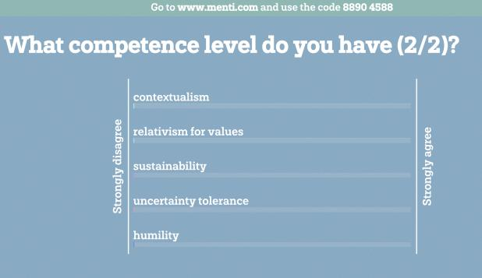
menti.com
8890 4588

Slide 30
Wisdom helps balance VUCA and SC²
1. changing perspectives
2. empathy
3. awareness & acceptance of own emotions
4. emotional balance, serenity
5. knowledge about facts & problem solving
6. contextualism
7. relativism for values
8. oriented towards sustainability
9. uncertainty tolerance
10. self distance
Volatility
Stability
Uncertainty
Certainty
Complexity
Simplicity
Ambiguity
Clarity
Creating your own balance of perceptions

Slide 31
Now - go and become wiser,
master your life better,
improve society and the world,
and do not fear VUCA but embrace it.

Slide 32
menti.com
5065 4496
Notes:
The late Rushworth Kidder was a researcher for human values and ethics. He founded the Institute for Global Ethics in 1990.
In quintessence he found most humans in most tribes and cultures to share common human values. We all have negative feelings if one of those values is violated by ourselves or even others. On the opposite, we feel touched and happy if we see the values being upheld.
The first 4 values listed you also find in PMI’s Code of Ethics and Professional Conduct. PMI did not know the research of Rushworth Kidder, but the volunteers concentrating on them when they formulated the Code seemed to have a good understanding about their own feelings.
The last 4 values, freedom, relatedness, care and humility can be observed during crisis’ like Corona.

