Slide 1
The Human Side of The Project Economy™
PMI Ghana Chapter
October 2020
Thomas Walenta
thwalenta@online.de
(fearless vision)

Slide 2
You are the reason I speak here today
As Project Managers …
You are the leaders of teams and customers into a positive future. You provide safety and security.
You will find some practical and some philosophical ideas in my pitch. You may ask questions at the end or in the chat. You can get the deck.
It is up to you, if you want to deep dive or try out some ideas. Or read a book. You may also contact me to discuss further.
In the global profession, in PMI, in the Chapter you find like-minded people with similar problems – connect and help build the PM hive
Nobody knows what will be in a year (and never did) – but we all can connect today in order to openly and fairly share ideas for the next steps

Slide 3
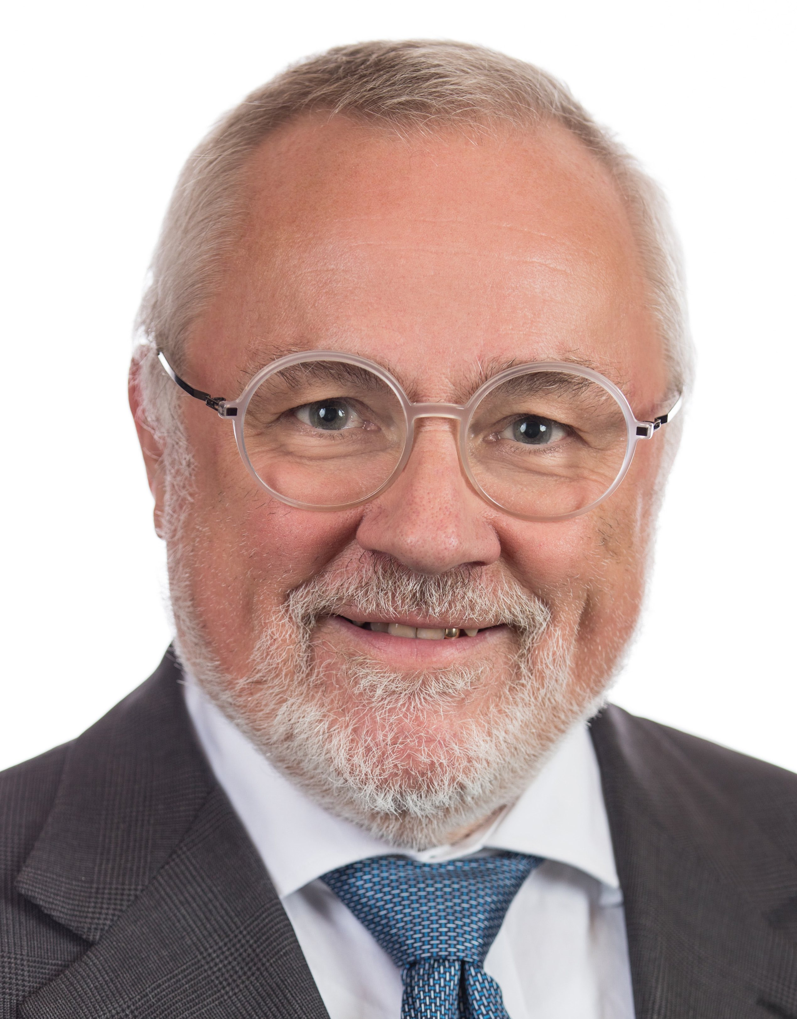
Thomas Walenta
decide 4 PM career
Retired
first project
start @ IBM
Panasonic
freelance
1974
1983
1988
2002
2014
teach @ university
University Mathematics
mentor/coach
PMI
member
PMP
Fellow
PgMP
1992
1998
2012
2014
17-19
IPMA
member
Chapter 8yr
Board
Ethics 6 years
Board
Notes:
r

Slide 4
The Project Economy
Leader- ship and Ethics

Slide 5
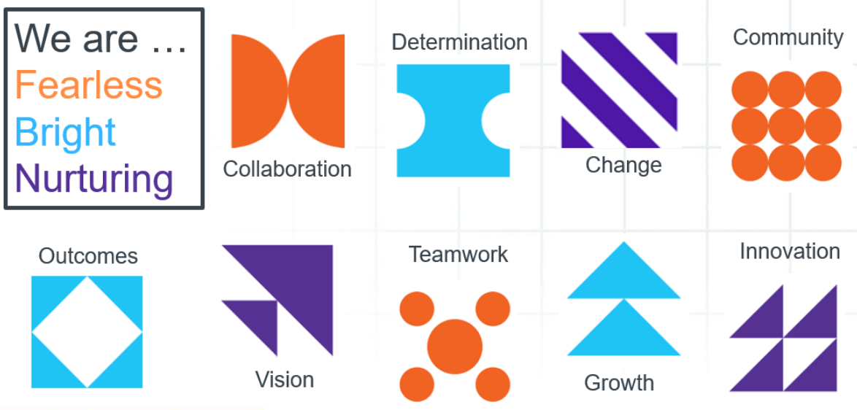
We (PMI) power The Project Economy™,
strengthening society by
enabling organizations and empowering people to
make ideas a reality.
Notes:
The demands of the project economy are enabling, extending, getting free from the constraints of the discipline of project management as we know it. The project economy includes frameworks for project, program and portfolio management, as well as change management, business analytics and benefits realization. It is about extending the focus on project delivery towards the creation of value. This extension intended by the project economy is necessary, as we enter the era of articificial intelligence, of exponential growth and of increasing speed of change. Many perceive the world and their individual environment as complex and lack the mental models to cope with their anxiousness. Project management is here to help. project managers are the leaders that show how to murph fears into hope, chaos into structure and complexity into simplicity. The Project Economy is intended to benefit society and it is doing this by improving how organizations in the private, public and social sectors organize work but also how individuals - of any age between 5 and 75 - can be enabled to make ideas a reality. Some of these people are needed to be the leaders, the influencers, the trusted guides to the future.

Slide 6
The Project Economy™ extends project management into the future
Project Economy
Project mgmt

Slide 7
The Project Economy™ extends project management into the future
PMI added more aspects to project management over time
Brightline: strategy gap
Project Economy
PMI
Transformation compass
Program mgmt
Disciplined Agile
Project mgmt
Code of Ethics
Portfolio mgmt
PMI Educational Foundation: age 5-19

Slide 8
The Project Economy™ extends project management into the future
There are even more things going on in the world, quicker and quicker
Brightline: strategy gap
Project Economy
PMI
Transformation compass
World
Program mgmt
Digitalization / AI
Agile
Disciplined Agile
Project mgmt
Code of Ethics
Leadership / Team 2.0
Portfolio mgmt
Globalization (Human Hive)
PMI Educational Foundation: age 5-19

Slide 9
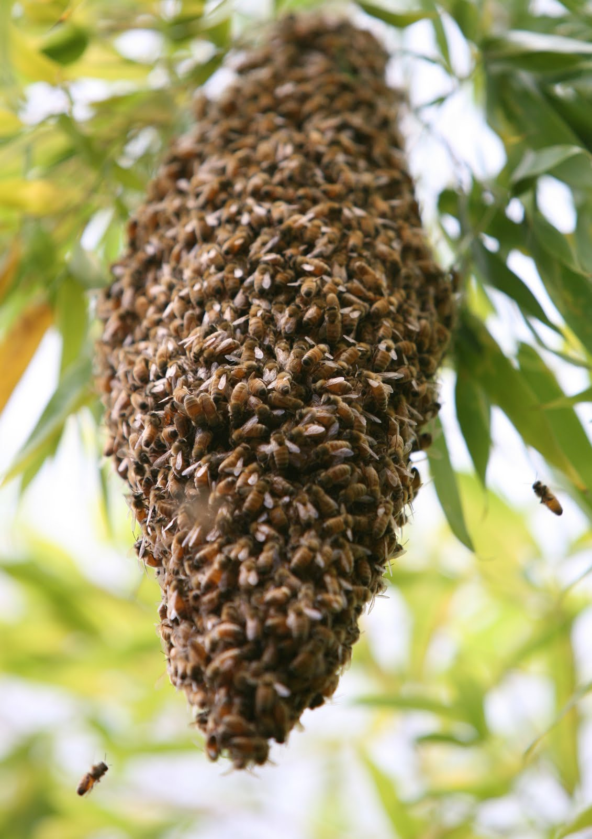
The Human Hive – a not so far future scenario
many connected individuals – 9 billion in 2030, 2020: 4 billion connected
intensified communication, between all – internet/5G, access everywhere, brain computer interface + social skills, physical distancing, real-time
global internet – Elon Musk’s Starlink 42k+ satellites (2022: 1440)
common rites and behaviors – go back to human values
different roles / capabilities still needed – specialty skills, AI?
hive is more important than any individual (utilitarism) - value of community stronger than that of individual freedom
Term coined by Singularity University
Notes:
The demands of the project economy are enabling, extending, getting free from the constraints of the discipline of project management as we know it. The project economy includes frameworks for project, program and portfolio management, as well as change management, business analytics and benefits realization. It is about extending the focus on project delivery towards the creation of value. This extension intended by the project economy is necessary, as we enter the era of articificial intelligence, of exponential growth and of increasing speed of change. Many perceive the world and their individual environment as complex and lack the mental models to cope with their anxiousness. Project management is here to help. project managers are the leaders that show how to murph fears into hope, chaos into structure and complexity into simplicity. The Project Economy is intended to benefit society and it is doing this by improving how organizations in the private, public and social sectors organize work but also how individuals - of any age between 5 and 75 - can be enabled to make ideas a reality. Some of these people are needed to be the leaders, the influencers, the trusted guides to the future.

Slide 10
The Human Hive – enhanced by Ubuntu
Ubuntu: Belief that we are one human family 'A person is a person through other people’ – ‘I am because you are’
3 aspects, 9 elements of Ubuntu
attitudes: dignity, respect, tolerance
behaviors: listening, honesty, conflict solution
relationships: community, belonging, interdependence
A growing human hive may lead to
extreme diversity and hence unprecedented creativity
new forms of power from scale, inclusion
changes in governance (role of nations?, governments?)
democratization and demonetization
Notes:
The demands of the project economy are enabling, extending, getting free from the constraints of the discipline of project management as we know it. The project economy includes frameworks for project, program and portfolio management, as well as change management, business analytics and benefits realization. It is about extending the focus on project delivery towards the creation of value. This extension intended by the project economy is necessary, as we enter the era of articificial intelligence, of exponential growth and of increasing speed of change. Many perceive the world and their individual environment as complex and lack the mental models to cope with their anxiousness. Project management is here to help. project managers are the leaders that show how to murph fears into hope, chaos into structure and complexity into simplicity. The Project Economy is intended to benefit society and it is doing this by improving how organizations in the private, public and social sectors organize work but also how individuals - of any age between 5 and 75 - can be enabled to make ideas a reality. Some of these people are needed to be the leaders, the influencers, the trusted guides to the future.

Slide 11
The Project Economy™ extends project management into the future Leading to a flexible North Star, which is much more than traditional PM
Brightline: strategy gap
Project Economy
PMI
Society
Transformation compass
World
Operations to projects
Program mgmt
Digitalization / AI
BIM
Roles to gig jobs
Agile
Disciplined Agile
Project mgmt
Code of Ethics
Leadership / Team 2.0
Age 5-75
Portfolio mgmt
Globalization (Human Hive)
Hope
Security
PMI Educational Foundation: age 5-19
Resilience

Slide 12
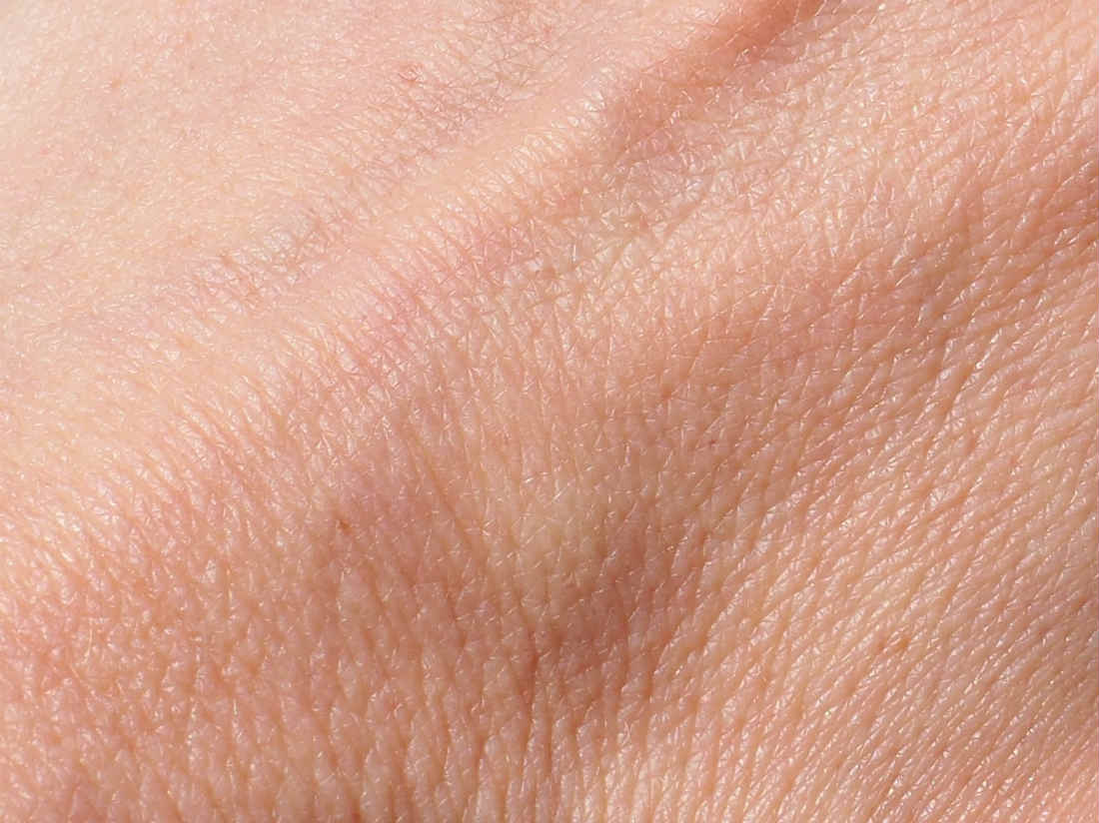
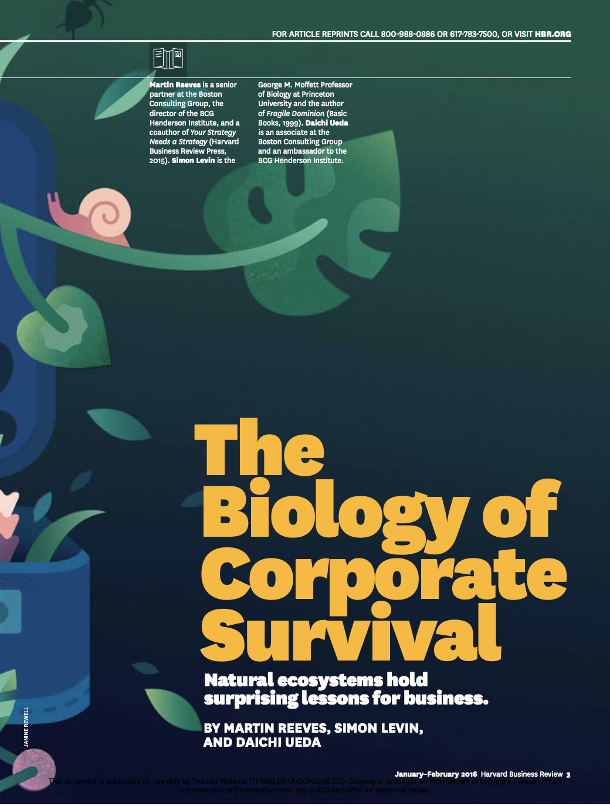
Becoming more resilent - six principles (Martin Reeves/Simon Levin on HBR 01/2016)
Resilience is the capability to master deep change without crisis (Hamel, ‚Quest for Resilience‘)
Resilience is preparation for disruption
Structure:
Modularity: autonomy, interconnected parts, known interfaces
Redundancy: mutual backup/checks
Heterogenity/Diversity: multiple options, different perspectives
Behaviors:
Prudence: mindfulness, explore and test, expect surprise
Embeddedness: sensitive to context, trust & reciprocity
Adaptability: flexibility, growth, sensing, feedback loops
Notes:
Six principles that make a natural CAS robust apply to companies, which should: • maintain
heterogeneity of people, ideas, and endeavors
sustain a modular structure
preserve redundancy among components
• expect surprise, but reduce uncertainty • create feedback loops and adaptive mechanisms • foster trust and reciprocity in their business ecosystems

Slide 13
The Project Economy
Leader- ship and Ethics

Slide 14
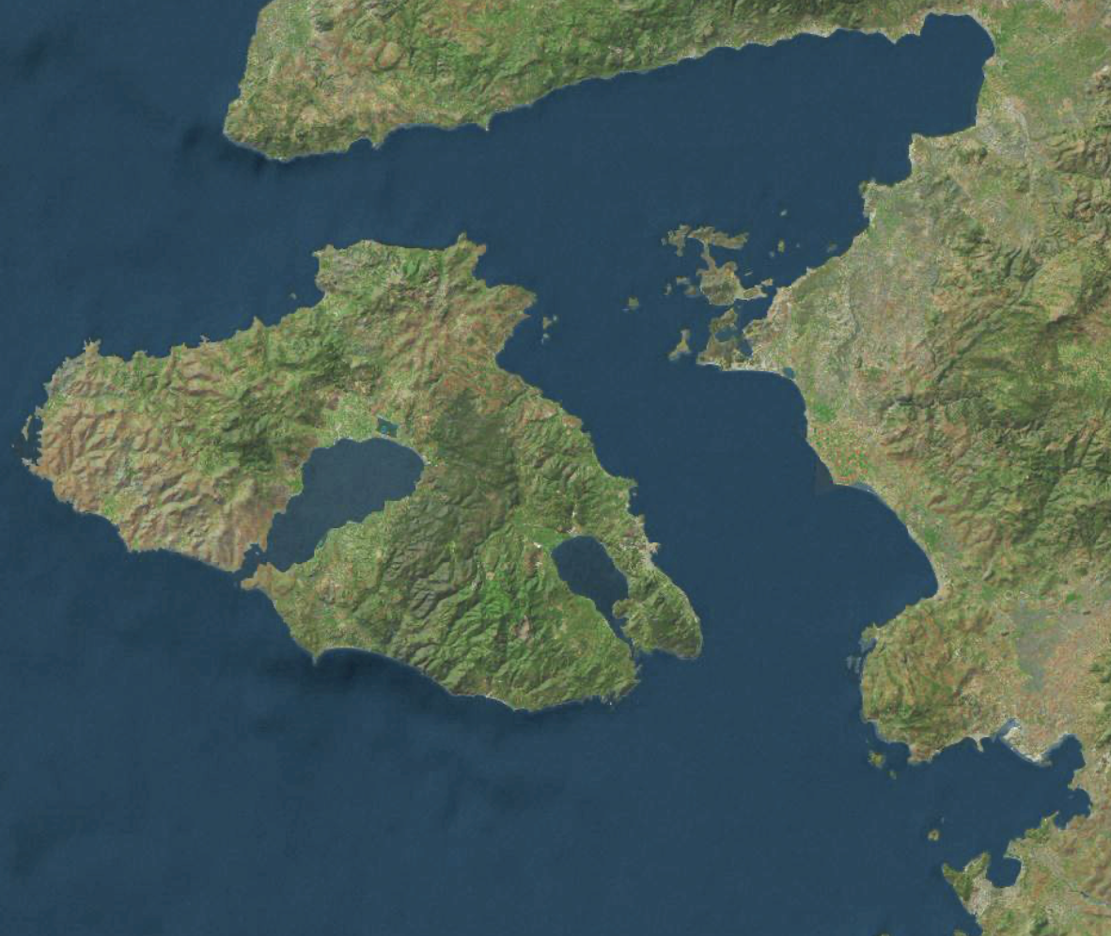
A good person, a trusted leader, a successful project
Project:
Go from Turkey to Lesbos, 25km
A motor dhingi designed for 6, loaded with 19 - 2015
Yusra Mardini from Damascus, Syria
Swimming Champion,
17 years old
motor stopped, boat took water
Yusra jumped in sea, followed by 3 others
pulling the boat, keeping it afloat
after 3 hours motor started – all were saved
Vision
Action
Results
Notes:
Growing up in Darayya, a suburb of Damascus,^{[3]} Yusra Mardini (*5.3.1998) trained in swimming with the support of the Syrian Olympic Committee.^{[4]} In 2012, she represented Syria in the 2012 FINA World Swimming Championships (25 m) 200 metre individual medley, 200 metre freestyle and 400 metre freestyle events.^{[5]}
Mardini's house was destroyed in the Syrian Civil War.^{[6]} Mardini and her sister Sara decided to flee Syria in August 2015.^{[7]} They reached Lebanon, and then Turkey, where they arranged to be smuggled into Greece by boat with 18 other migrants,^{[7]} though the boat was meant to be used by no more than 6 or 7 people.^{[4]} After the motor stopped working and the dinghy began to take on water in the Aegean Sea, Yusra, her sister, Sara, and two other people who were able to swim^{[4]} got into the water and treaded water for over 3 hours until the engine started working again, and the group reached Lesbos.^{[7]} ^{[8]} They then traveled through Europe to Germany, where they settled in Berlin in September 2015.^{[4]} Her parents also fled Syria and live in Germany.^{[9]}

Slide 15
Ethical values describe triggers to our emotions
8 human values found in most human cultures (Rushworth Kidder)
Responsibility, accountability
Respect, mindfulness, tolerance, diversity
PMI Code of Ethics and
Professional Responsibility
Fairness, justice, equitable
Honesty, truth, integrity
Freedom, autonomy
Community, family, relatedness
Compassion, care, love, help
Compassion, Care, Love
Humility, reverence for life

Slide 16
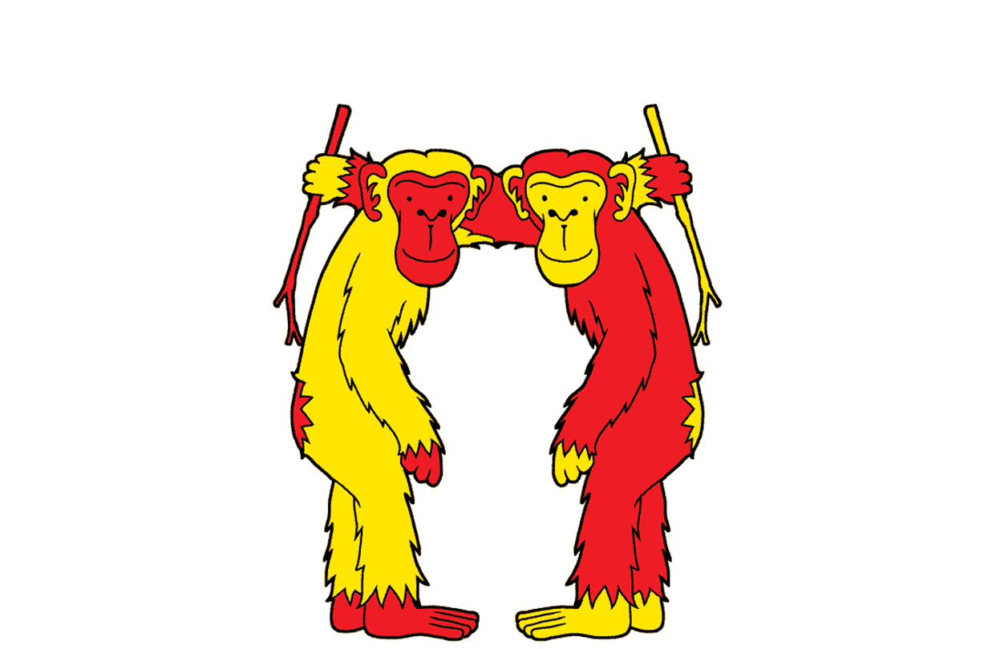
Example:
How fairness and reciprocity developed during evolution

Slide 17
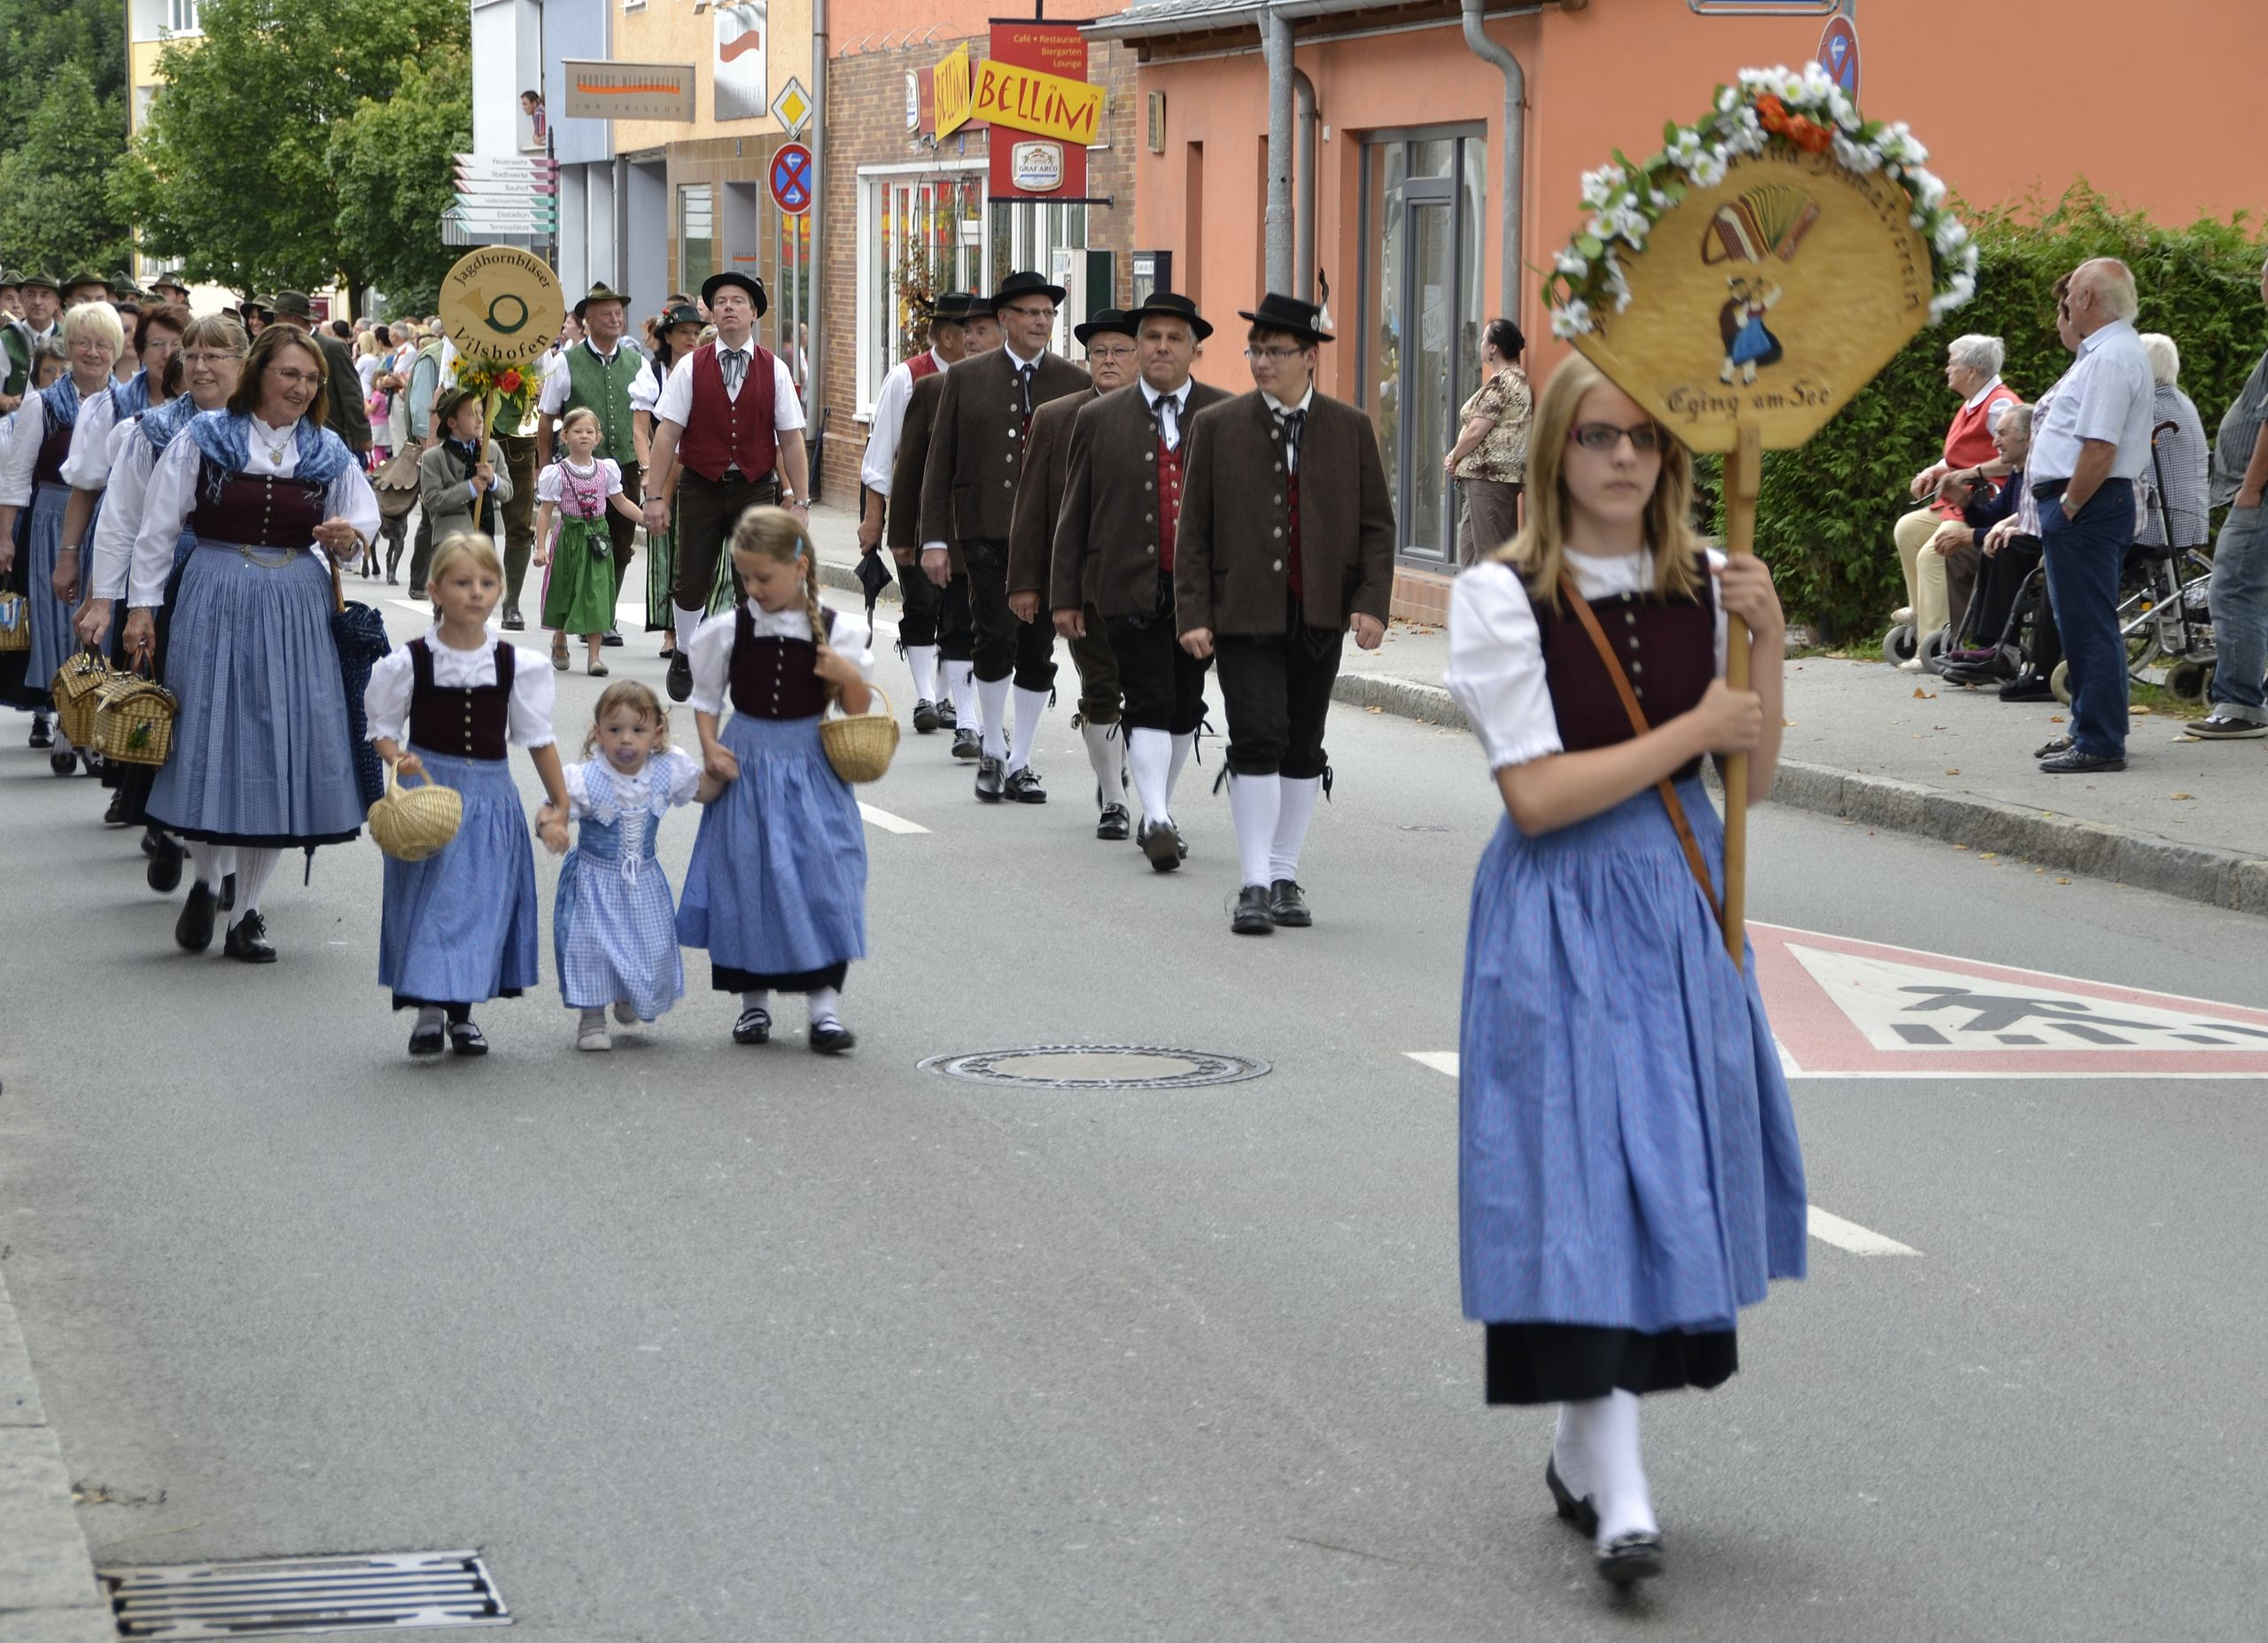
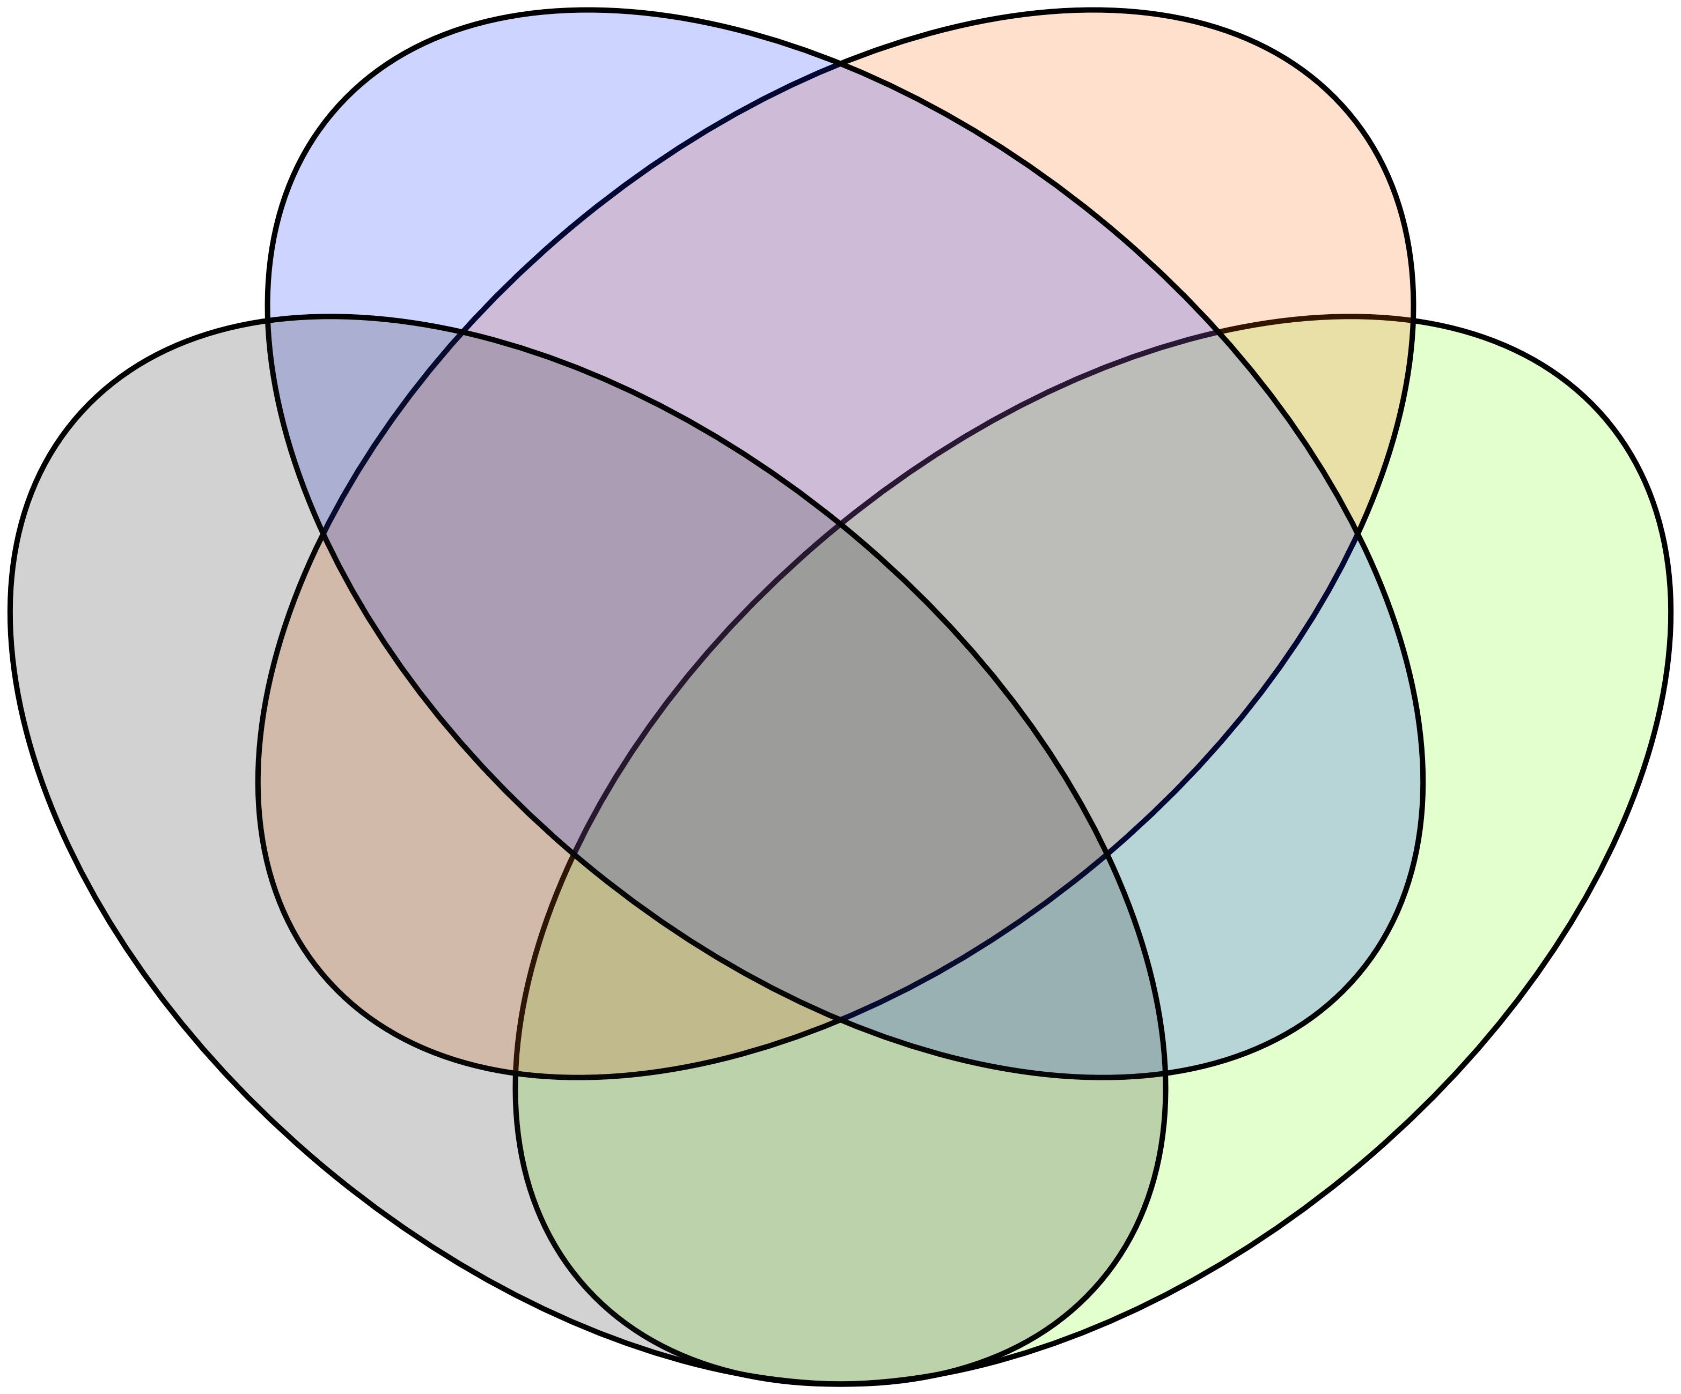
Some characteristics of ethical values
My ethical values – voluntarily limit my options for my action (tools can be used for ethical and unethical purposes)
Culture is represented by e.g. common behaviors, rites, norms, signs, perspectives, beliefs and values
Values connect people, they are commonly accepted & felt by humans
Beliefs divide, they define communities, are based on transferred experience If beliefs are challenged, e.g. by disruptions of communities, values become more visible
We all are part of many communities and their specific cultures: Family, Spouse, School, Job-role, Company, Profession, Hobby, Clubs, Nation, Ethnicity, Gender, Religion, Language
Our identity is created in the intersection of these cultures
me

Slide 18
What does it mean to be good (ethical) person?
What can I be to make project success more probable?
How can I interact with others for this?
How can I support the team to be effective?
me
Behave ethical
they
Build trust
we
Lead effectively
it
Succeed with the team
Notes:
18

Slide 19
Emotional Intelligence – a base for leadership
compassion: self-motivation, flow
self awareness: confidence, authenticity
self control: mindfulness, resilience
empathy: learning, understanding, listen organizational awareness
influence: leadership, impact, conflict handling, negotiations
me
observe
act
Stakeholder Management
you

Slide 20
Becoming a good person
(based on HBR article 01/2020)
“become a good ancestor”
self-awareness
Plan & prepare
Make Decisions
Rehearse & learn
build resilience
eulogy virtues
share dilemmas
prepare scenarios: What if..
ask for feedback
let people know
get a mentor
avoid unethical
people / places
supportive habits
stay calm
obtain help
self-control
resist social pressure
multiple perspectives

Slide 21
How to make good decisions?
stay calm, avoid stress
build EI self-control
decisions: avoid rationali-zations
publicity test
change perspectives
search for ethical issues
resist social pressure
obtain help
mirror test
ownership = be responsible
generalization test
deontology (action / duty based)
utilitarism (consequence based)
virtue ethics (Aristotle / Confucius)
is it OK if published?
what do I think about this decision maker?
is this a good example for others?
ombudsman, mentor, frameworks
follows prescribed moral principles - Codes
it provides highest value to most
it shows I am a morally good person - character
Notes:
21

Slide 22
Ethical decisions
Ethical decision-making types (Rushworth Kidder):
Good-bad (easy – for most sane people)
Good-good (dilemma), needs balance, experience, depends on situation
shall I be honest and tell him he has a stain on his shirt or shall I respect him as he is and not embarrass him? Honesty vs. respect.
I am responsible to reduce headcount, how to be fair and respectful
Moral courage (heroic) - implement, personal consequences, leadership action
whistleblower,
not taking bribes,
standup against bullies
best: reframe the dilemma so it becomes a solution

Slide 23
Reframing = changing perspectives
Value 2
reframe
Value 1
Value 1
Value 2
Widen your window of observation, so both values belong to the same reality – because they do.
Get from confrontation to conversation and creation.
be honest and respectful
be accountable and fair
Design Thinking
helps with reframing
(here: double diamond)
reframe

Slide 24
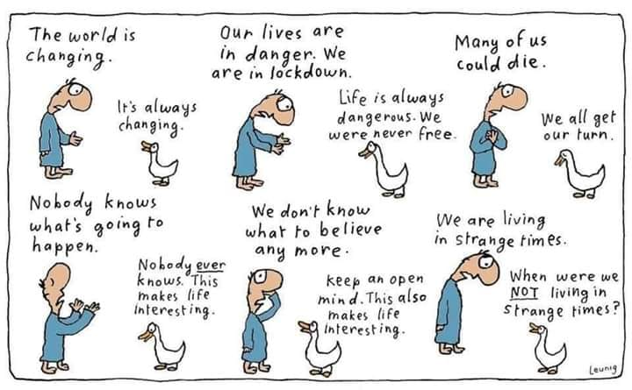
Perspectives drive emotions drive behaviors drive change

Slide 25
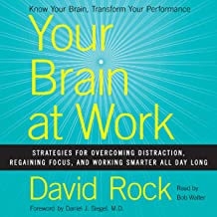
Neuroleadership – SCARF (by David Rock) a tool to improve emotional intelligence (self control and influence)
5 automatically triggered
emotions (David Rock)
How humans feel if emotions are
triggered towards the emotion negatively vs. positively
Status
inferior
respected valued
Certainty
fear
courage hope
Autonomy
forced
empowered
Relatedness
lonely
protected
Fairness
unjust
equal

Slide 26
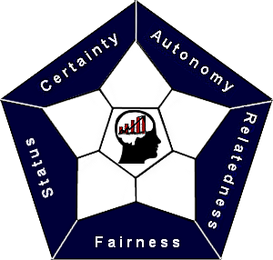
In order to lead and influence, we have to understand motivations that drive our reactions and try to smooth the triggers that might result in emotions
As Project Managers ….
You are the leaders of teams and customers into a positive future
You will find some practical and some philosophical ideas in my pitch. You may ask questions at the end or in the chat. You can get the deck.
It is up to you, if you want to deep dive or try out some ideas. Or read a book. You may also contact me to discuss further.
In the global profession, in PMI, in the Chapter you find like-minded people with similar problems – connect and help build the PM hive
Nobody knows what will be in a year (and never did) – but we all can connect today in order to openly and fairly share ideas for the next steps
Status
Certainty
Autonomy
SCARF
(David Rock)
davidrock.net/
Relatedness
Fairness

Slide 27
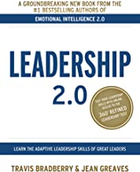
Leadership competencies / treats
Core Leadership Competencies (Bradbury/Greaves)
Strategy
Vision
Acumen
Planning
Courage to lead
Action
Decisiveness
Communication
Mobilizing others
Results
Risk taking
Results focus
Agility
Vision
Action
Results

Slide 28
Leadership can be seen when you perceive a shift ..
From | To
Uncertainty | Certainty
Chaos | Structure
Fear | Hope
Vision | Results
Activism | Plan
Waste | Discipline
Hesitation | Decision
Narrow view | Reframing
Confrontation | Conversation
Leadership is absorption of insecurity (Clausewitz)

Slide 29
Everyone is a Leader

