Slide 1
The Role of Leadership in Economic Development and National Progress
PMI Open Lecture
Prof Pikay Richardson, BSc, MSc, PhD
Visiting Senior Fellow
Alliance Manchester Business School,
University of Manchester;
Fellow in Economics
Humboldt University, Berlin
Notes:
1

Slide 2
Prof Pikay Richardson, BSc, Msc, PhD
Degrees in Engineering and Management.
Visiting Senior Fellow, Alliance Manchester Business School, University of Manchester, Manchester, UK
Institute Fellow, GBZ, Humboldt University, Berlin, Germany
Formerly Professor and Academic Director, NJIT, Newark, NJ, USA.
Expertise: Business Economics; Strategic Management; Organisational Behaviour; Leadership Development; Int. Business; Corporate Government and Ethics.
International experience in 26 Countries on Four Continents, including UK, US, France, Germany, China, India, Bangladesh, Hong Kong, Malaysia, Singapore, Dubai, South Africa, Botswana, Ethiopia, Kenya, Jamaica, Barbados, Nigeria, and Ghana.

Slide 3
Human Effort and Results
Things Work ONLY if we make them work.

Slide 4
Human Progress: The Factors
Competence; Knowledge; Know-how; Skill
The Will; Heart; Desire; Dedication; Keenness to get accomplished What has been determined as the Right Thing to do, and doing it Right (Effective Leadership)
Resources (Money/Capital)

Slide 5
Leadership: The Vital Ingredient
System design, System Change
The Right Things v/s Things Right
Policy formulation, Strategy and Execution
Providing direction and guidance
Providing Hope
Societal, national, organisational progress
In every area of human endeavour the primary ingredient for success is LEADERSHIP

Slide 6
Leadership and the Status Quo
Every system is perfectly designed to get the results that it is getting today.

Slide 7
Leadership and the Status Quo
Every system is perfectly designed to get the results that it is getting today.
For a different of better results, the system needs to change. This requires Leadership

Slide 8
Setting the Scene: Africa Within A Globalising World
Some Development Comparisons and Policies

Slide 9
People in Extreme Poverty (less $1 day) Mns
 | 1981 | 1990 | 2001 | 2015
Sub-Saharan Africa | 164 | 227 | 313 | 340
LA & Caribbean | 36 | 49 | 30 | 43
ME & NA | 9 | 6 | 7 | 4
Europe & Central Asia | 3 | 2 | 17 | 2
East Asia & Pacific | 796 | 472 | 271 | 19
South Asia | 475 | 462 | 451 | 216
Source: WDI (WB)

Slide 10
People in Extreme Poverty, % of population
1980-89 1990-2004 2014
Ghana 44 45 47
Nigeria 67 71 70
Zimbabwe 34 56 60
Chile 15 20 18
Singapore 0 0 0
South Korea 16 2 1
Malaysia 27 4 2
China 33 17 17
India 48 35 34
Bangladesh 86 36 38

Slide 11
Life Expectancy at Birth, Years
1960 1990 2004 2010
Ghana 45 55 60 59
Nigeria 40 52 55 55
Zimbabwe 45 60 47 44
Chile 57 72 75 75
Singapore 65 74 79 79
South Korea 54 70 72 72
Malaysia 54 70 74 73
China 47 70 70 71
India 44 59 63 63
Bangladesh 40 52 58 58
United Kingdom 70 78 80 80

Slide 12
Global Marginalisation? - Level of IC GDP/Capita (%)
 | 1965 | 1995 | 2004
Asian Tigers | 18 | 66 | 67
Sub-Saharan Africa | 14 | 7 | 5

Slide 13
Shares of Global GDP, Int$ PPP, %
1950 1973 2003
WE 26.2 25.6 19.2
LA 7.8 8.7 7.7
Asia, (Jap) 1.6 16.4 33.9
Africa 3.8 3.4 3.2
US 27.3 22.1 20.6
Japan 3.0 7.8 6.5
China 4.6 4.6 15.1
World 100 100 100 (40913tr)
Source: Maddison, 2007
Notes:
13

Slide 14
Reasons for poor Economic Performance- Poor or Ineffective Leadership
External conditions – inability to shake off legacy of centuries of slavery and colonial rule, neo-colonialism.
Heavy dependence of a small number of primary products; no diversification
Internal politics, characterised by authoritarianism, corruption and political instability.
Economic policies – protectionism, statism, fiscal profligacy or indiscipline, no planning, etc.
Demography – rapid population growth.
Social conditions – deep ethnic divisions, low levels of social capital.

Slide 15
Now the Session Thesis
Prosperity
derives from
Economic Development
in turn, derives from
Good Governance,
which in turn derives from
Visionary/Strategic Leadership

Slide 16
The Model
Good Governance
Economic Development Progress
Effective Leadership
HDI
Public/private

Slide 17
The Model
HDI

Slide 18
Bettering the Quality of Life
High and growing per capita Income
Good and improving Health, Life Expectancy
Improving Education, skilled workforce and improving earning power, together,
Improving HDI

Slide 19
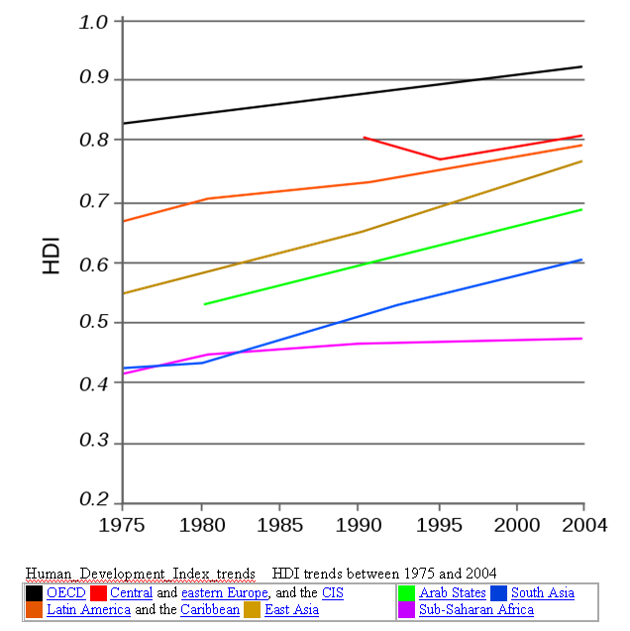
Human Development Index

Slide 20
The Model
Economic Development Progress
HDI

Slide 21
Economic Development/Growth
- Growth of Firms’ Output
- Growth of National Income (GDP)
K
Q
L
Leads to Improved Quality of Life
Black
Box

Slide 22
Policies for Prosperity What others did:
Macro-economic stability
Good governance
Strong disciplined institutions
Openness
Productive skilled labour
Improved corporate competitiveness
Good investment climate
Good supply-side policies

Slide 23
Lee Kuan Yew and Singapore
Three main concerns
National security
Economic development
Social issues and harmony
Results: pc Income
1960 1995 2003
Nigeria 329 355 461
SA 1800 2100 3230
India 206 425 559
Singapore 405 21000 28000
Notes:
23

Slide 24
The Model
Good Governance
Economic Development Progress
HDI
Public/private

Slide 25
Good Governance Regime
Governance:
The manner is which power is exercised in the management of a country’s social and economic resources for development (Public and Corporate)

Slide 26
Characteristics of a Good Public Governance Regime
Participation
Rule of law
Transparency
Responsiveness
Equity
Effectiveness and efficiency
Strategic vision
Taking advantage of globalisation

Slide 27
Governance and the Public Sector
Develop and implement development policies and programmes
Create an efficient, effective and responsive public service
Promote an environment conducive to wealth creation by the private sector
Establish and manage and effective transparent regulatory and legal environment

Slide 28
Governance and the Public Sector, cont.
Address the issue of accountability in the public service
Enhance institutions that promote and enforce the rule of law
Manage the changing roles of the public sector in the context of globalisation
Cultivate and nurture an environment that will accelerate poverty reduction and sustainable development

Slide 29
Governance and the Private Sector (Corporate Governance)
Promote efficient and competitive services
Compete efficiently in the global economy
Improve productivity and output
Undertake R&D
Dialogue effectively with other stakeholders – public sector, civil society – in order to influence the policy agenda
Establish codes of practice
Enhance corporate governance and social responsibility

Slide 30
Governance and Leadership
Good Governance is concerned with one thing – the good and progress of society.
The essential ingredient for this is Good and Effective Leadership

Slide 31
The Model
Good Governance
Economic Development Progress
Effective Leadership
HDI
Public/private

Slide 32
Re-cap: Leadership and the Status Quo
Every system is perfectly designed to get the results that it is getting today.
For a different of better results, the system needs to change. This requires Leadership

Slide 33
Leadership
Leadership is a process whereby an individual influences a group of individuals to achieve a common goal.

Slide 34
Effective Leadership
the development of vision and strategies, the alignment of relevant people behind those strategies, and the empowerment of individuals to make the vision happen despite obstacles
- Kotter

Slide 35
Dimensions of Who Leaders Are?
Three Components:
Knowledge
Sense of Service
Courage and Conviction

Slide 36
What are the Mark of Leaders – What Do Leaders Do?
Ability to determine the best way forward, and lead the way to achieve it.
Ability to develop/adapt
Ability to collaborate
Ability to Lead teams
Non-authoritarian
Consistent exceptional performer
Ambitious for human progress
Notes:
36

Slide 37
The Challenge of Leadership
Leaders develop Vision, set Agendas, align people behind them, and get organisations/nations to charge in the direction of progress.
Notes:
37

Slide 38
Hence
* Lack of Good Leadership, leads to
* Lack of Good Governance, which in turn leads to
* Poor micro/macro-economic Performance, and
* Slow or nil Economic Growth

Slide 39
Re-cap - The Model
Good Governance
Economic Development Progress
Effective Leadership
HDI
Public/private

Slide 40
Re-cap: Finale
Things work ONLY if we make them work.

Slide 41
Established in Creation
If you plant a good Tree, you harvest good Fruit.
Matthew 7:17-20
¹⁷ A good tree produces good fruit, and a bad tree produces bad fruit. ¹⁸ A good tree can’t produce bad fruit, and a bad tree can’t produce good fruit. ¹⁹ So every tree that does not produce good fruit is chopped down and thrown into the fire. ²⁰ Yes, just as you can identify a tree by its fruit, so you can identify people by their actions.

Slide 42
Established in Creation
If you plant a good Tree, you harvest good Fruit.
Luke 6:44
No good tree bears bad fruit, nor does a bad tree bear good fruit. Luke 6:44 For each tree is known by its own fruit. Indeed, figs are not gathered from thornbushes, nor grapes from brambles.

Slide 43
Finale
Things work, ONLY if we make them work,
Things work, ONLY as well as we make them work.

Slide 44
Thank you
Pikay Richardson, BSc, MSc, PhD
Email: Pikay Richardson@yahoo.com
pikay.Richardson@manchester.ac.uk
Te; +44 772 065 418

Slide 46
Prof. Pikay Richardson, BSc, MSc, PhD
* Degrees in Engineering and Management.
* 17 years: Snr. Fellow, Manchester Business School; Prof. of Business, UB, Gaborone.
* 2 years: Professor and Academic Director, NJIT, Newark, NJ, USA.
* Teaching Expertise: Economics; Strategy; Leadership; Marketing, Int. Business, OB.
* International experience: UK, US, France, Dubai, Germany, China, India, Ghana, SA, Hong Kong, Singapore, Malaysia, Botswana, Nigeria, Jamaica.

Slide 47
Lee Kuan Yew and Singapore
Three main concerns
National security
Economic development
Social issues and harmony
Results: pc Income
1960 1995 2003
Nigeria 329 355 461
SA 1800 2100 3230
India 206 425 559
Singapore 405 21000 28000
Notes:
47

